Slide 1
Lecture 19

Slide 3
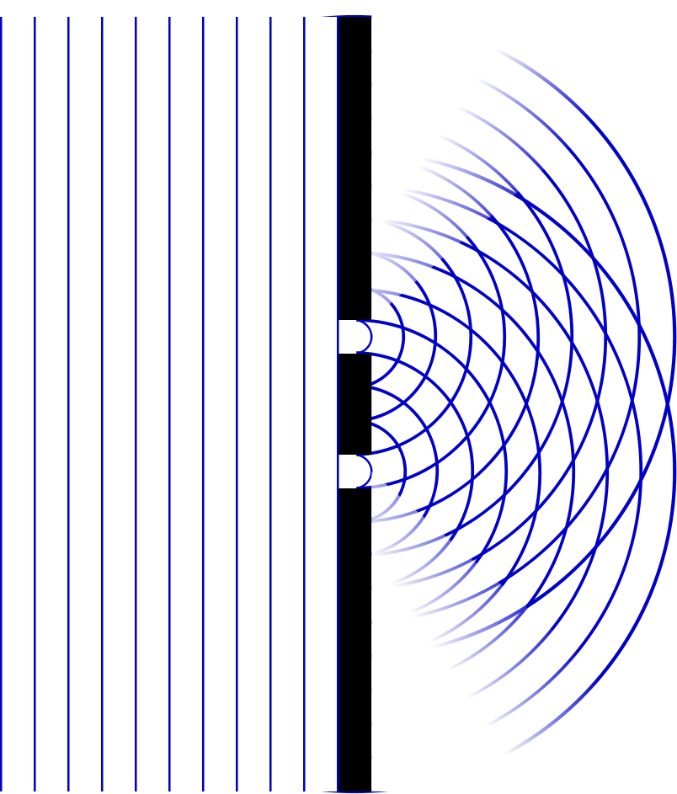

Slide 4
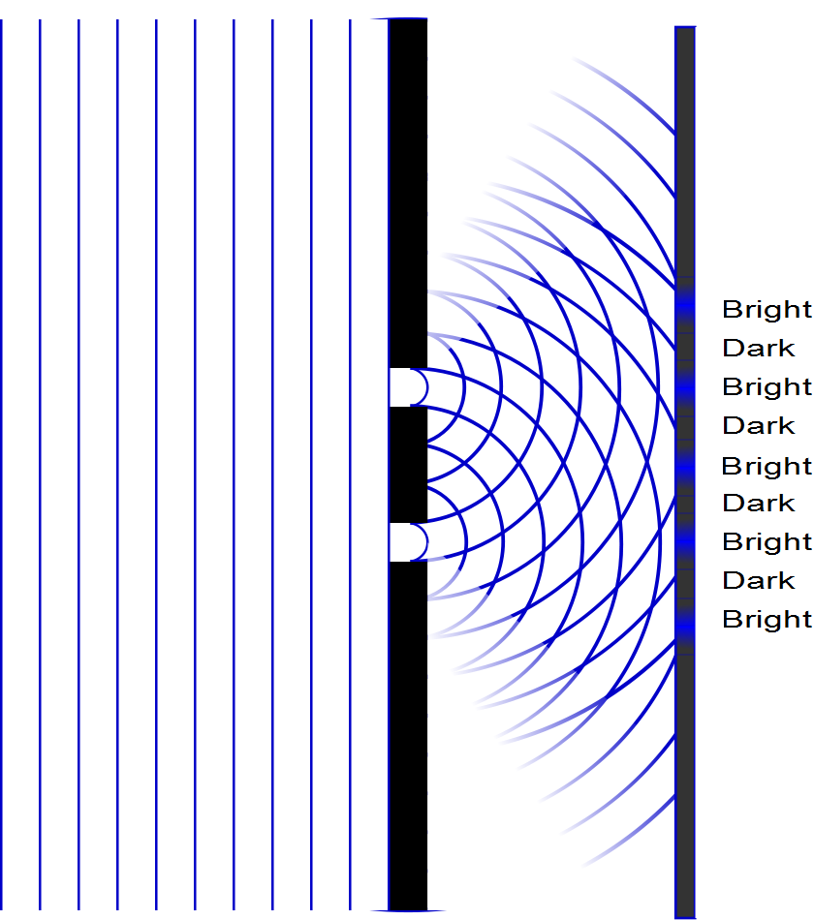

Slide 5
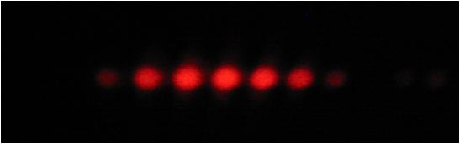

Slide 8
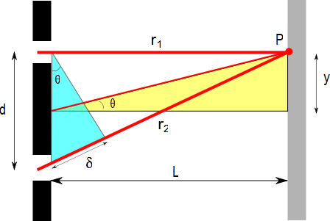
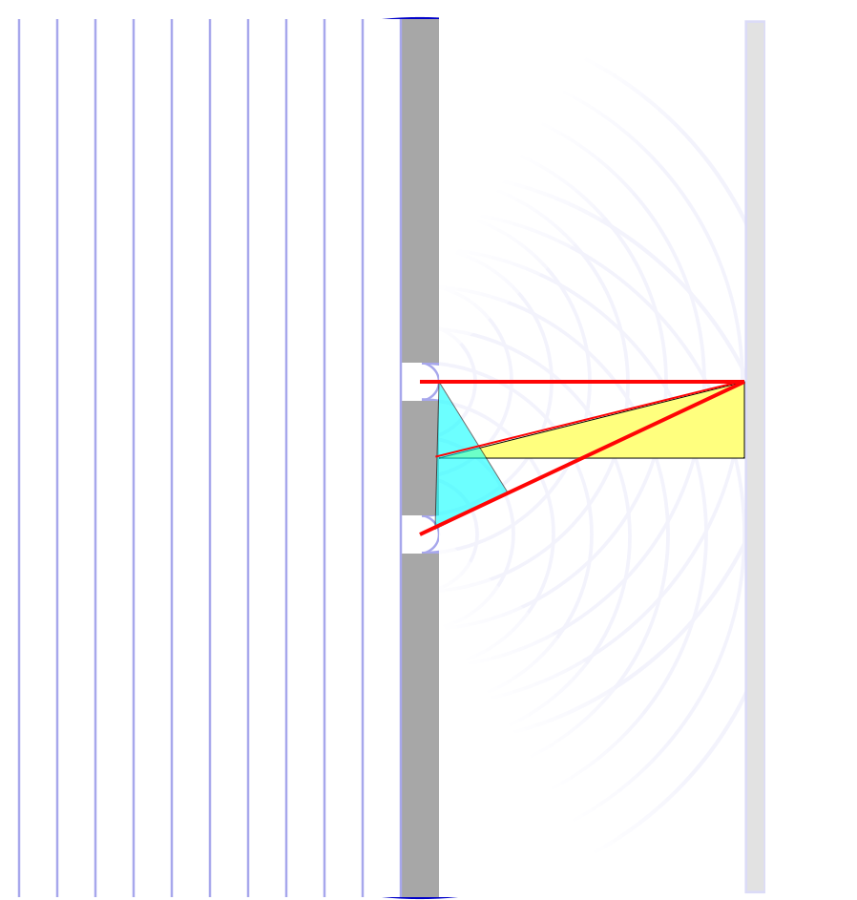

$$∆r$$

Slide 9
ConcepTest 24.3a Double Slits I
In a double-slit experiment, when the wavelength of the light is increased, the interference pattern
spreads out
stays the same
shrinks together
disappears

Slide 10
ConcepTest 24.3a Double Slits I
In a double-slit experiment, when the wavelength of the light is increased, the interference pattern
spreads out
stays the same
shrinks together
disappears
d sin θ = m λ
If λ is increased and d does not change, then θ must increase, so the pattern spreads out.

Slide 11
ConcepTest 24.3b Double Slits II
If instead the slits are moved farther apart (without changing the wavelength) the interference pattern
spreads out
stays the same
shrinks together
disappears

Slide 12
ConcepTest 24.3b Double Slits II
If instead the slits are moved farther apart (without changing the wavelength) the interference pattern
spreads out
stays the same
shrinks together
disappears
d sin θ = m λ
If instead d is increased and λ does not change, then θ must decrease, so the pattern shrinks together
Follow-up: When would the interference pattern disappear?

Slide 13
ConcepTest 24.4 Path Difference
In a double-slit experiment, what path difference have the waves from each slit traveled to give a minimum at the indicated position?
there is no difference
half a wavelength
one wavelength
three wavelengths
more than three wavelengths
Intensity

Slide 14
ConcepTest 24.4 Path Difference
In a double-slit experiment, what path difference have the waves from each slit traveled to give a minimum at the indicated position?
there is no difference
half a wavelength
one wavelength
three wavelengths
more than three wavelengths
λ
For Destructive Interference
δ = 1/2 λ, 3/2 λ, 5/2 λ, 7/2 λ, …
= (m + 1/2) λ
2λ
3λ
Intensity
λ/2
3λ/2
5λ/2
7λ/2

Slide 15
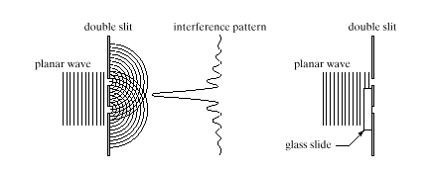
ConcepTest 24.5 Interference Pattern
pattern vanishes
pattern expands
bright and dark spots are interchanged
pattern shrinks
no change at all
An interference pattern is seen from two slits. Now cover one slit with glass, introducing a phase difference of 180° (1/2 wavelength) at the slits. How is the pattern altered?
Double slit Interference pattern
wave

Slide 16
ConcepTest 24.5 Interference Pattern
An interference pattern is seen from two slits. Now cover one slit with glass, introducing a phase difference of 180° (1/2 wavelength) at the slits. How is the pattern altered?
pattern vanishes
pattern expands
bright and dark spots are interchanged
pattern shrinks
no change at all
If the waves originating from the two slits have a phase difference of 180° when they start off, the central spot will now be dark !! To the left and the right, there will be bright spots. Thus, bright and dark spots are interchanged.
Double slit Interference pattern
wave
Follow-up: What happens when the phase difference is 90°?

Slide 17
Problem
Suppose we have a laser beam that produces pretty red light with λ=632.8nm . And suppose we shine this laser on an opaque screen with two slits that are 0.200mm apart. And suppose we let the light hit a screen that is 5.00m away from the slits. How far apart will the bright interference fringes be on the screen?
Opaque screen with slits
Observing Screen
Δy
Laser
d = 0.200mm
5m

Slide 20
I
Interference fringes:
due to having two slits.
φ/2
-5π
-3π
-π
π
3π
5π

Slide 21
Question
Screen
I now have three “slits” with light going through them. What will I see on the screen?
Just a blur of light
Still bright spots and dark spots
Nothing, most of the light doesn’t get through
Exactly three bright spots

Slide 22
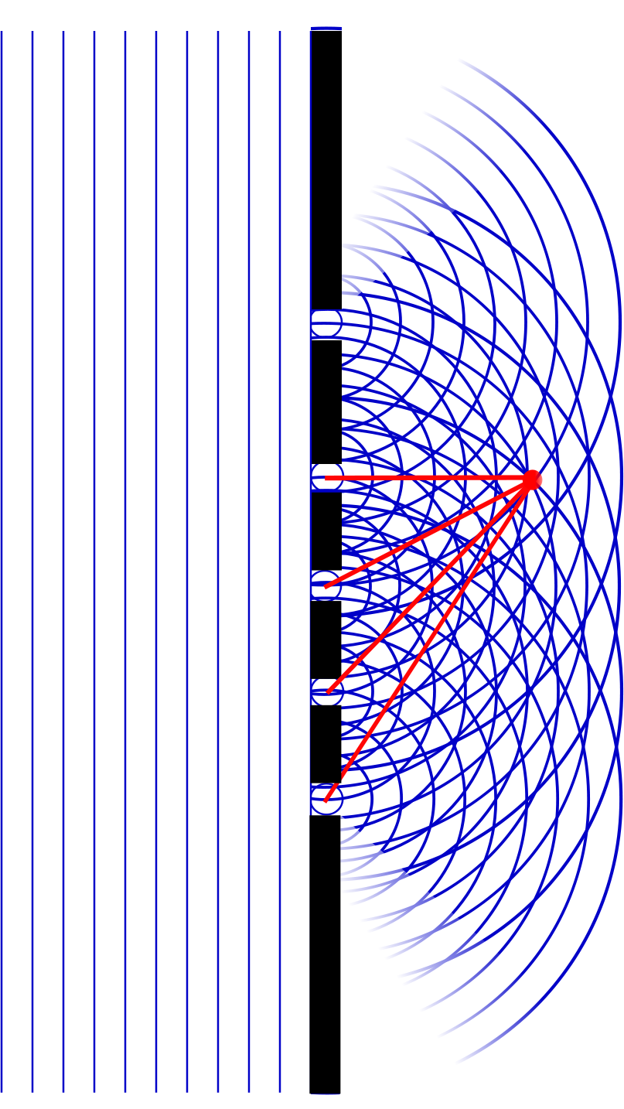

Slide 23
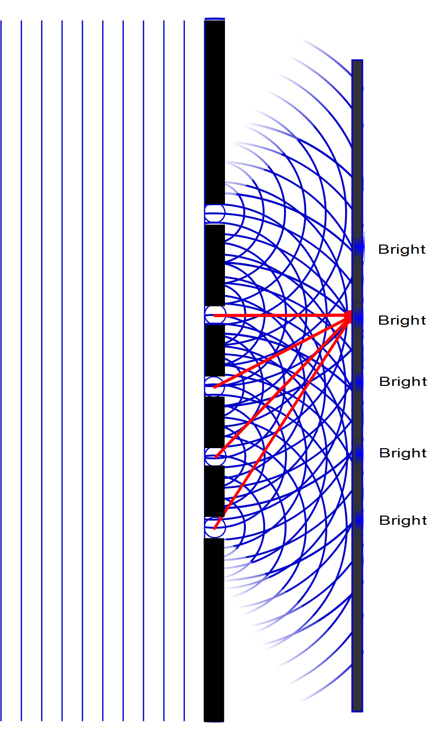

Slide 24
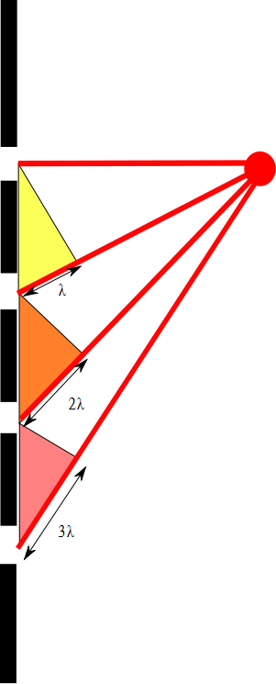

Slide 25

One Slit
Two Slits
Three Slits
Four Slits
Five Slits
Six Slits
Principle Maxima
Secondary Maxima

Slide 26
END

Slide 27
Question 14.4.1
In which state of matter are the atoms that make up the matter most tightly bound by electrical forces?
Solid
Liquid
Gas
Plasma

Slide 28
m
m
m
m
m
m
m
m
m
m
m
m
m
m
m
m
m
m
m
m
m
m
m
m

Slide 29
m
m
m
m
m
m
m
m
m
m
m
m
m
m
m
m
m
m

Slide 30
m
m
m
m
m
m
m

Slide 31
m
m
m
m
m
m

Slide 32
Fluid Mechanics
Fluids: Randomly arranged collections of molecules
Gases
Liquids
Solids?
No shearing stresses
No Tensile stresses

Slide 33
Question 123.4.2
Suppose you are standing directly behind someone who steps back and accidentally stomps on your foot with the heel of one shoe. Would you be better off if that person were
(a) a large professional basket ball player wearing sneakers
(b) a petite woman wearing spike-heeled shoes?

Slide 34
Question 123.4.3
Consider what happens when you push both a pin and the blunt end of a pen against your skin with the same force. What will determine whether your skin will be punctured?
a) the pressure on your skin
b) the net applied force on your skin
c) both pressure and net applied force are equivalent
d) neither pressure nor net applied force are relevant here
G

Slide 35
Problem
A 50.0kg woman balances on one heel of a pair of high heeled shoes. If the heel is circular and has a radius of 0.5000cm , what pressure does she exert on the floor?

Slide 36
Problem
How much larger is the pressure at the bottom of a swimming pool than the pressure at the pool surface?

Slide 37
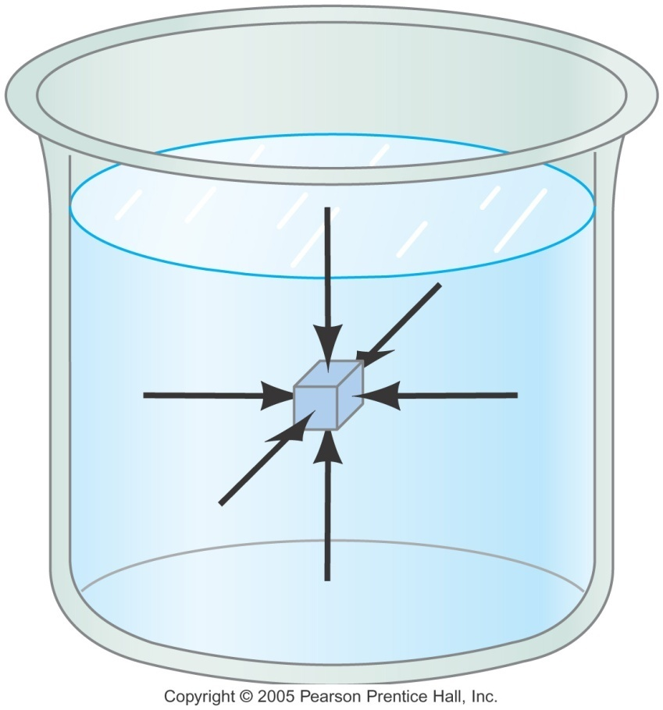
Pressure
P is Scalar quantity
SI Unit is the Pascal

Slide 38
Question 123.4.4
You are walking out on a frozen lake and you begin to hear the ice cracking beneath you. What is your best strategy for getting off the ice safely?
a) stand absolutely still and don’t move a muscle
b) jump up and down to lessen your contact time with the ice
c) try to leap in one bound to the bank of the lake
d) shuffle your feet (without lifting them) to move towards shore
e) lie down flat on the ice and crawl toward shore
G

Slide 39
Question 123.4.5
Two dams are exactly the same size (same width and depth). One (A) holds back a large lake, the other (B) holds back a small river. Which Dam has to be built stronger?
A
B
Neither, they should be the same
A
To Sugar City
Dam
B

Slide 40
Question 123.4.9
When a hole is made in the side of a can holding fluid, the fluid flows out of the hole. The path the water follows is shown in the picture. If the container is dropped in free fall, the water flow will:
a) diminish
b) stop altogether
c) go out in a straight line
d) curve upwards

Slide 41
Question 123.4.6
Which has a greater force do to the fluid acting on the base?
A B
Hint: Which has a greater total weight?
Lead

Slide 42
Pressure and Depth (2 of 3)
F_{pt}
F_{pml}
-F_{pmr}
If we use our new definition of pressure
F_{pb}
W
Sides
-P_{o}Aĵ
Top
P_{m}A x
-P_{m}A x
Bottom
PAĵ
Mg

Slide 43
Pressure and Depth (3 of 3)
Substitution yields:
So we find that the pressure as a function of depth is given by
If we start at the surface,
-P_{o}Aĵ
d
d+h
PAĵ
Mg

Slide 44
Pascal’s Law
If we change P_{o}, there must be a change in pressure throughout the entire fluid!
Pascal’s Law: a change in the pressure applied to a fluid is transmitted undiminished to every point of the fluid and to the walls of the container.

Slide 45
Question 123.4.7
Three containers are filled with water to the same height and have the same surface area at the base, but the total weight of water is different for each. Which container has the greatest total force acting on its base?
a) container 1
b) container 2
c) container 3
d) all three are equal
1
2
3

Slide 46
Question 123.4.8
How do Hydraulic Brakes Work?
A) The pressure due to the pedal being depressed compresses the fluid which then causes a force on the the brake pads
B) The force due to the pedal being depressed increases the pressure which is transmitted equally to the entire system, and causes a force on the brake pads
C) The force on the pedal causes a change in volume of the master cylinder which, in turn, causes there to be a higher pressure in the brake cylinder than exists in the master cylinder. This higher pressure causes a force on the brake pads

Slide 47
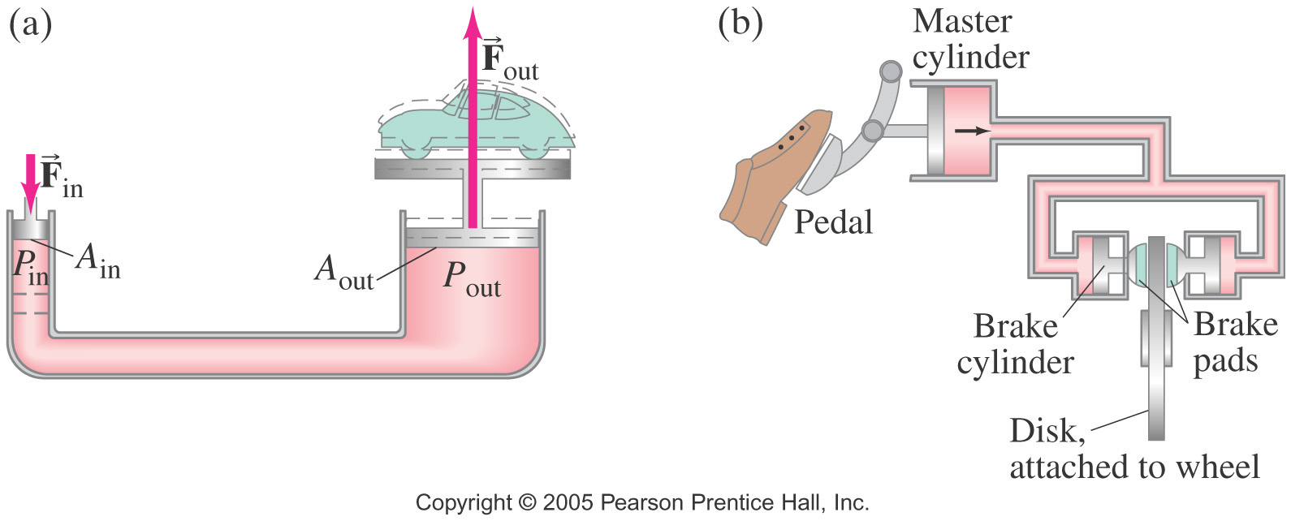
Question 123.4.8
How do Hydraulic Brakes Work?
A) The pressure due to the pedal being depressed compresses the fluid which then causes a force on the the brake pads
B) The force due to the pedal being depressed increases the pressure which is transmitted equally to the entire system, and causes a force on the brake pads
C) The force on the pedal causes a change in volume of the master cylinder which, in turn, causes there to be a higher pressure in the brake cylinder than exists in the master cylinder. This higher pressure causes a force on the brake pads

Slide 48
Problem
We push down on the small piston on the left. The pressure changes by an amount ΔP. How much does the pressure change in the right hand side of this jack?

Slide 49
Problem
We push down on the small piston on the left. The pressure changes by an amount ΔP. What is the upward force in the right hand side of the jack?

Slide 50
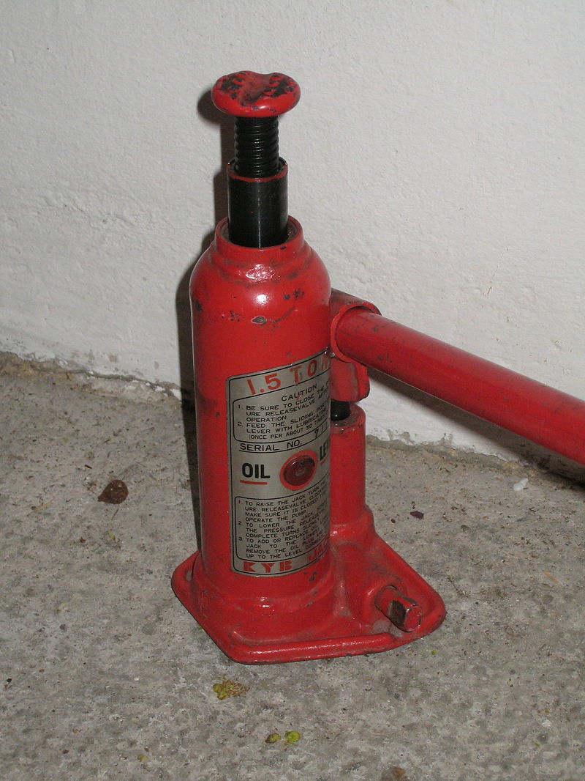
Small Cylinder
Big Cylinder

